Slide 1
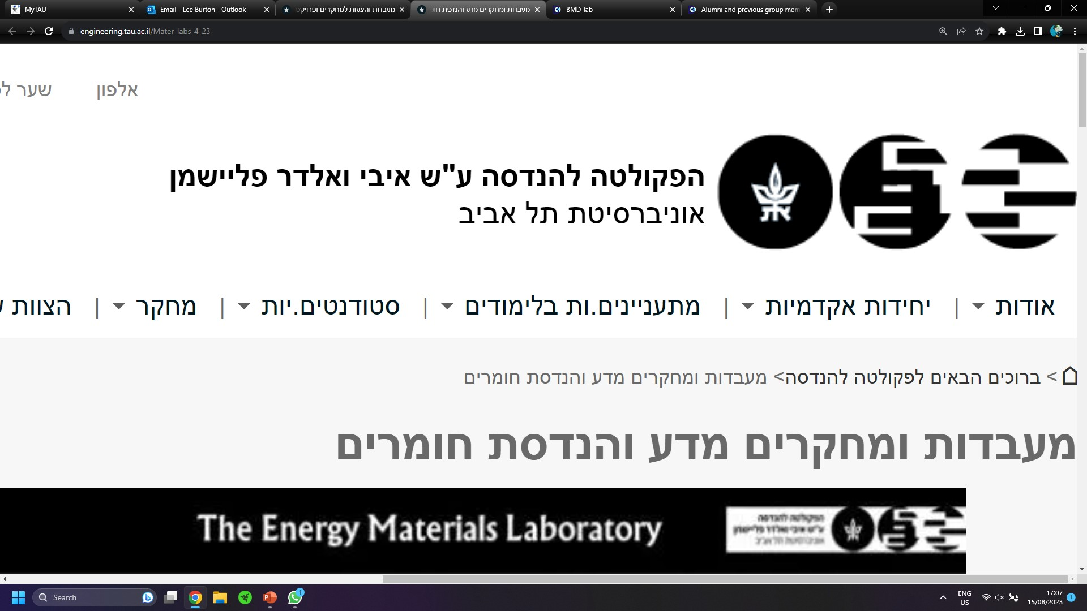

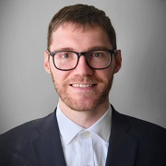
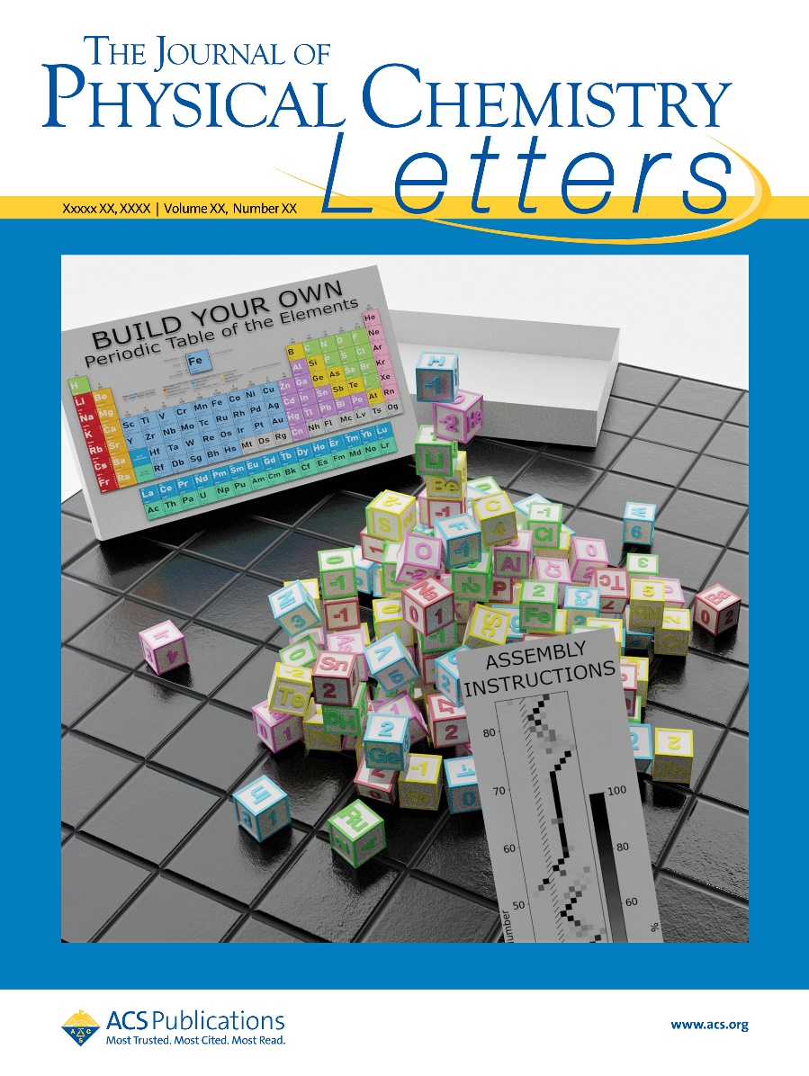
Burton Materials Discovery Lab
Dr Lee Burton
Areas of Interest:
Senior Lecturer
Data Driven Discovery
Materials Modelling
Machine Learning
Department of Materials Science and Engineering
Recent works as example projects:
Discovering new materials from atomic building-blocks
Modelling ion transport through porous materials
Predicting exotic electron behavior in new materials
leeburton@tauex.tau.ac.il

